Slide 1
Selling Quality at an Organization Level: Building an Effective Business Case
Penny Tootle, Utilligent Consulting

Slide 2
Consumer
Name A Service That You Would Pay For That You Believe Does Not Require a Quality Review Process.
Name a Product That You Would Purchase That You Believe Does Not Need to Incorporate a Quality Review Process During Production.
Name a type of Building or Structure That You Would Pay To Enter That You Believe Does Not Require a Quality Review Process During Construction.
Survey

Slide 3
Consumer
Select One Thing That Was Mentioned and Explain Why a Quality Process is Necessary.
Advocacy

Slide 4
…Building an Effective Business Case
Build Here
What You Believe
Is The Foundation of Your
Business Case!
Building Takes Bricks!
Materials!
Substance!
Labor!
Energy!

Slide 5
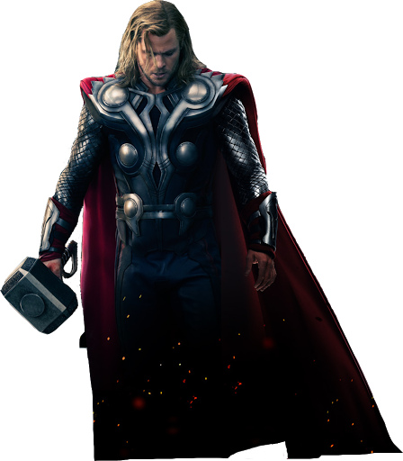
My Protection is Superior. I will Keep you safe.
“See the difference?”
Sure, I guess I can keep you safe.

Slide 6
?
?
?
?
?
Why do YOU need a quality program?
?
?
?

Slide 7
?
?
?
Group Collaboration!
?
?
What Problem?
?
?
?

Slide 8
State The Problem
Be Specific
Provide Clear Data Paths
Lead With Diplomacy & Tact

Slide 9
Selling Quality Does Not
Disregard What is Working
~~~
Quality Seeks to Replicate it
HOWEVER
Discovery Is Necessary to Uncover the Cause of What Is Not Working

Slide 10
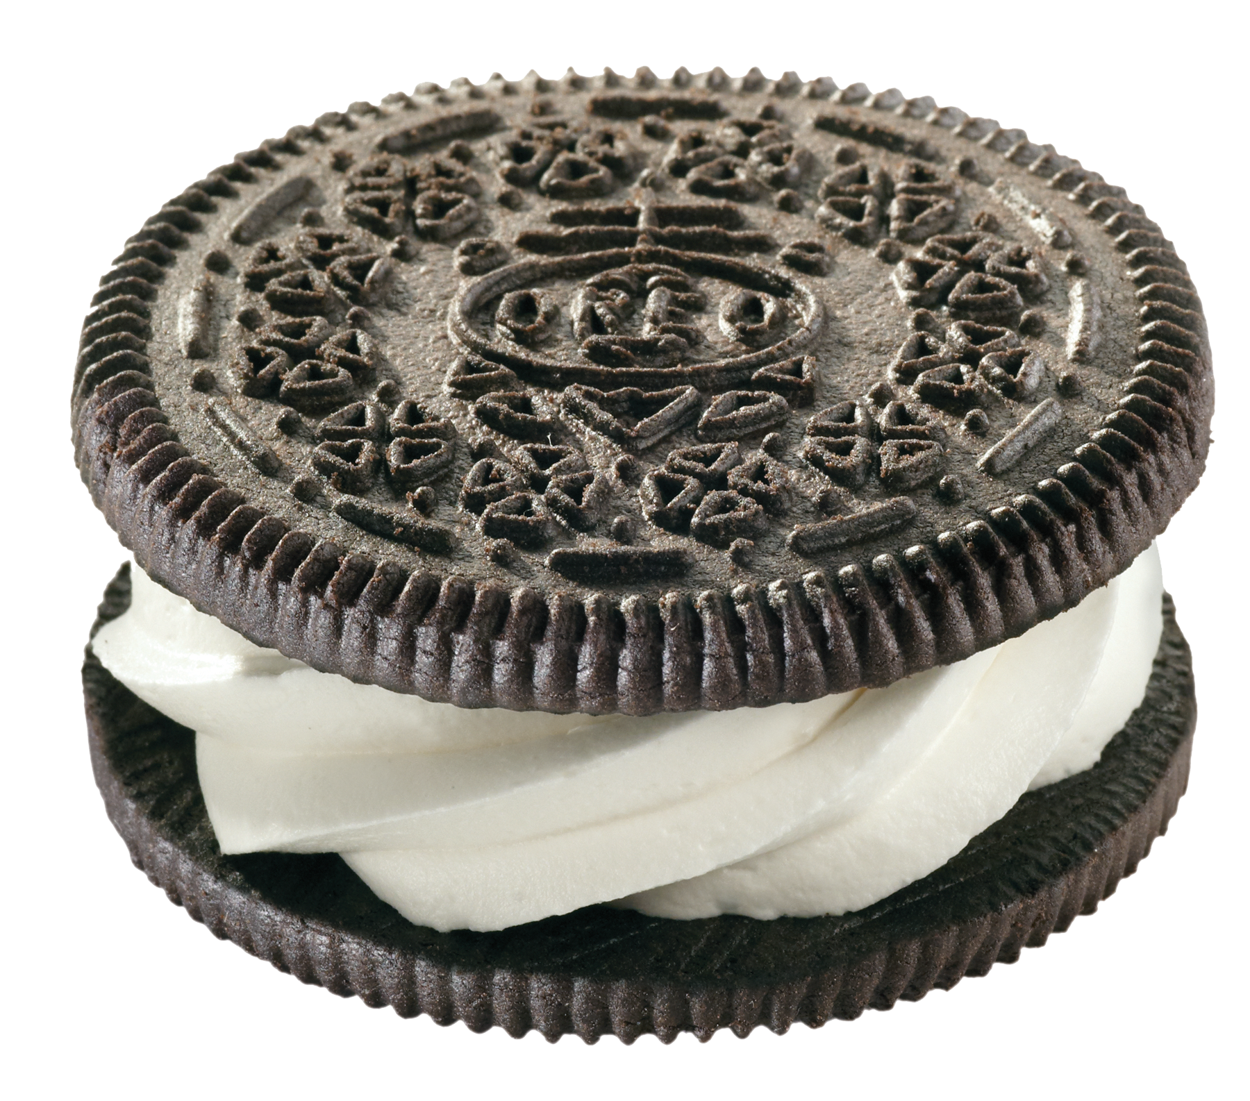
Brand Recognition
High Initial Sales
Unify Org-wide Practices
What we do well
What we need to well
What we want to do well
Customer Survey to Understand Gaps
Increased CSAT
Customer Loyalty
Award Recognition

Slide 11
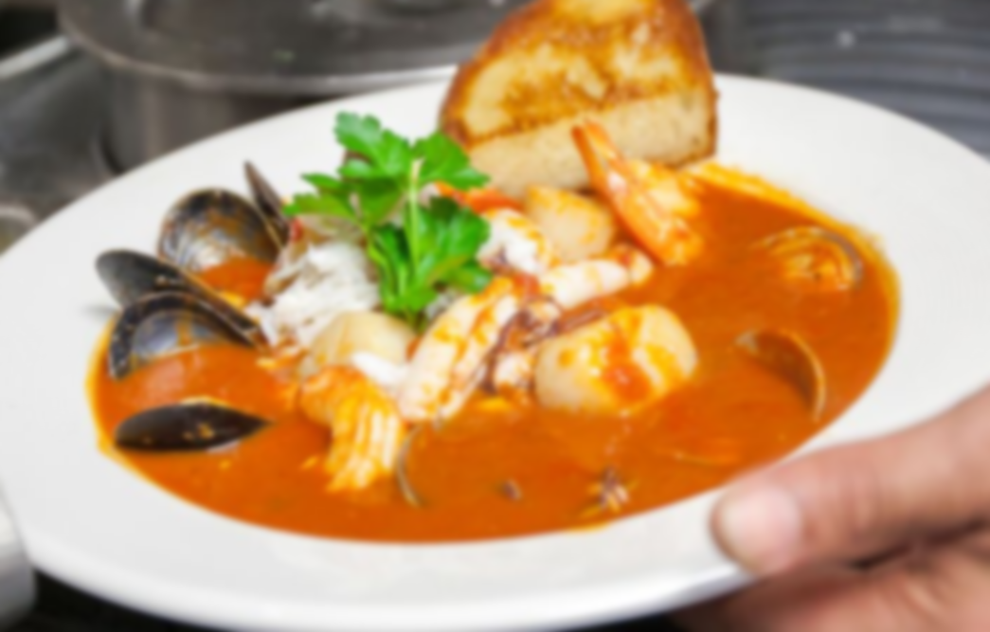
You are not just selling a quality program.
You are selling a culture.
You are making promises for the future.

Slide 12
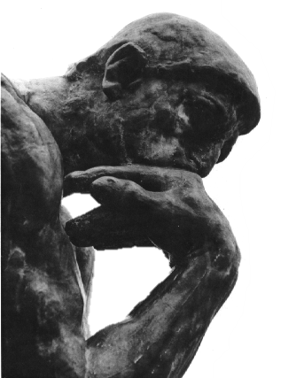
It’s obvious the CSR’s are giving bad information, leads and supervisors are failing to follow-up on complaints and the low handle-times are hang-ups to boost agent averages.
“Perhaps there is an opportunity for us to better interpret inquiries, better align our practice with company policy, and consider de-emphasizing call rates and emphasizing interaction results.”
Low Customer Satisfaction Scores
High Customer Escalation Rate
High Volume of Calls < 60 Seconds

Slide 13
…Building an Effective Business Case
Build Here
Combine Your Passion With Your Knowledge to Garner the Beneficial Attention
Business Cases are Built on Facts
Verified!
Quantified!
Known!
Impacting!

Slide 14
?
?
?
Group Collaboration!
?
?
What Problem?
?
?
?

Slide 15
Organizational Goal
1._____
2._____
3._____
Quality Opportunity
A._____
B._____
C._____

Slide 16
Collaborate and Enlist - Peer Support is Powerful!
“Associate yourself with people of good quality for it is better to be alone than in bad company.”
-Booker T. Washington
“Walking with a friend in the dark is better than walking alone in the light.”
-Helen Keller
“Teamwork makes the dream work but a vision becomes a nightmare when a leader has a big dream and a bad team.”
-John C. Maxwell

Slide 17
…Building an Effective Business Case
Build Here
Combine Your Passion With Respected Like Minded Colleagues
Cross Sell While You Build
Engage!
Educate!
Convince!
Enlist!

Slide 18
While You’re Here…
YOIROW toiungow igown
WEOTGG wgitonw to gwpgb
Uwpgnwo g wogn woglbkn goinw
YIOowpgnie gos tuelbmnw go
Plwowengoin eognw gwoien
glign soing
wgppstin
Zoitng lei ogionw geingsl gion
Asogin woginw goin
Gigwoing
Wekligo woilg o gooiieng ldlgieg
glign soing
wgppstin
Wgoing WOGg soinetg sgin
Zoitng lei ogionw geingsl gion
Xoitngow goinw gog I goewa xz
Asogin woginw goin
Gigwoing
DRAFT Plan A
DRAFT Plan B

Slide 19
Strategize on Approach

Slide 20
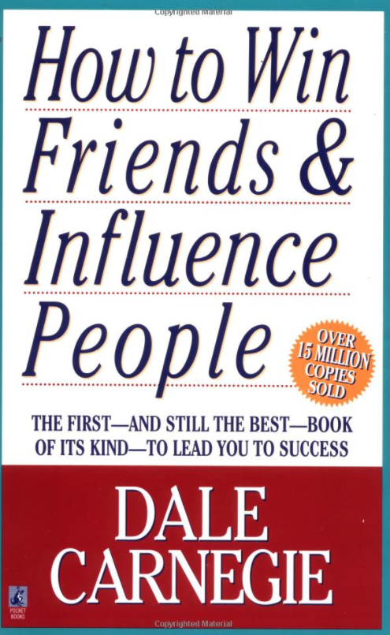
The Voice of Reason is Highly Regarded…. Even when not initially heeded.
Psst…
~career tip of the day~
Chair the “Friends of- Society”
Capture Achievable Goals
Chart a Reasonable Course
Provide Assurance of Support
Bring Respected Colleagues to Bear
Establish Next Actions
Give Decision Assignments
Commit to Follow-up Dates

Slide 21
Selling Quality at an Organization Level
is about
Building an Effective Business Case
that maximizes the value of YOU
Penny Tootle

Slide 22
THANk YOU!
Penny.tootle@Utilligent.com
Penny Tootle

